Slide 1

Budgeting and Savings Goal Tracker
By Team SavingsSavy

Slide 2

MEET THE SQUAD
Samuel Oluwadare Ademoyegun
Adebimpe Olabisi Adeoye
Pelumi Peace Olukayode
Oluwaseun Omotayo Alolanle
Zainab Omotola Ojo

Slide 3

PROBLEM STATEMENT
Many People struggle to keep track of their finances and maintain healthy spending habit due to various reasons such as:
Lack of visibility and control over their finances.
Challenges in resisting the urge to overspend due to increase in availability of credit cards, online shopping and other forms of instant gratifications.
A Budgeting and Savings tracker feature embedded in a mobile app can help users easily monitor their spending habits, expenses and track the progress set towards achievable savings goals.

Slide 4

OBJECTIVE
To Develop a user-friendly budgeting and savings tracker feature that enables users to easily monitor their finances and savings goals, empowering them to take control of their spending habits and achieve financial stability. The feature should allow users to set personalized budgets and savings goals, track their expenses, and receive personalized recommendations for achieving their financial objectives. The app should also provide users with a clear overview of their financial health and progress.

Slide 5


USER PERSONA
Goals
John wants to save money for his children’s college education and retirement. He also wants to pay off his mortgage early and build an emergency fund.
Challenges
John struggles to manage his finances due to irregular income and unexpected expenses related to his business. He also finds it hard to stick to a budget due to family obligations and occasional impulse purchases.
Name: Bimpe
Age: 40
Occupation: Small business owner
Education: High school diploma
Location: Suburban area

Slide 6



TOOLS AND TECHNOLOGIES USED
FIGMA
1
ANGULAR
2
3
NODE JS

Slide 7
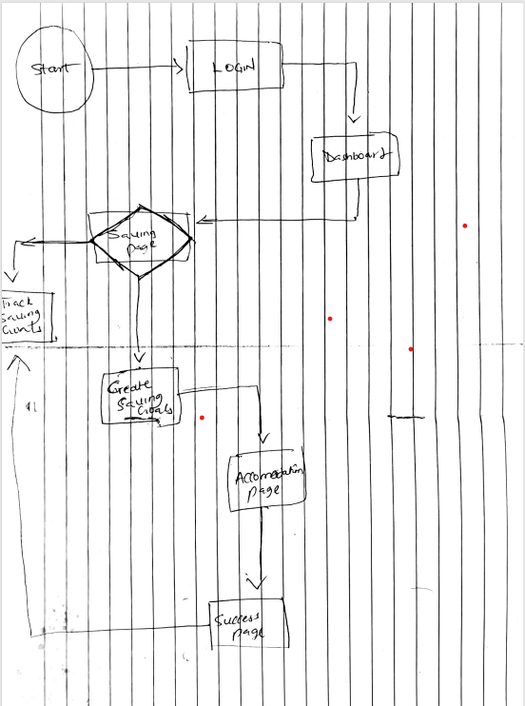
USER FLOW

Slide 8

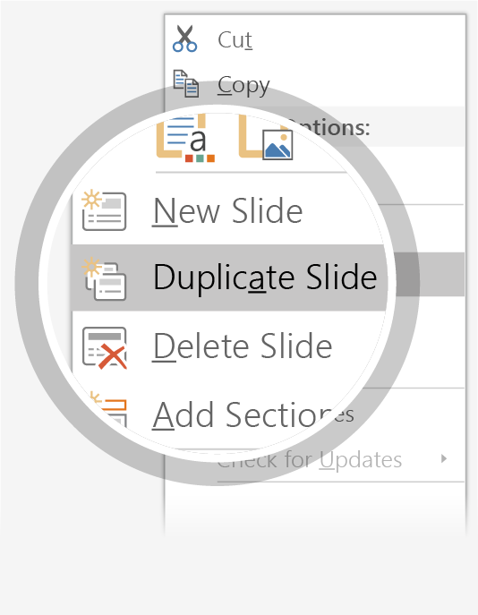
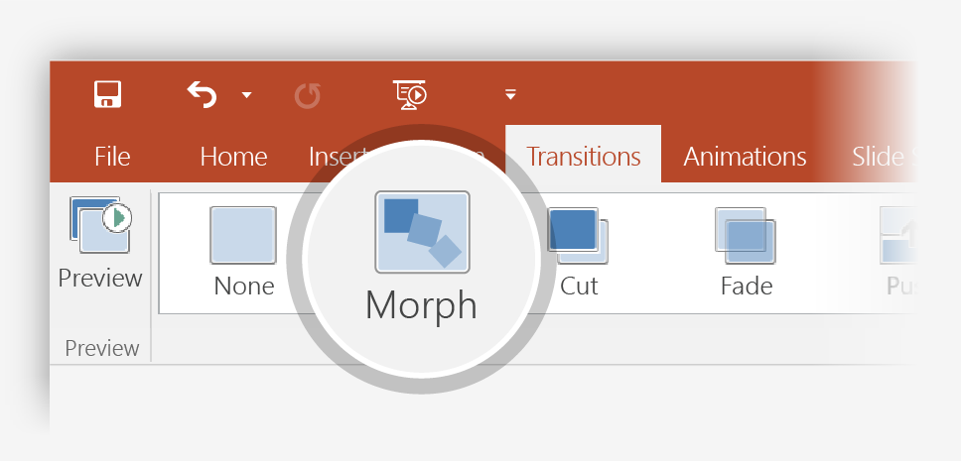
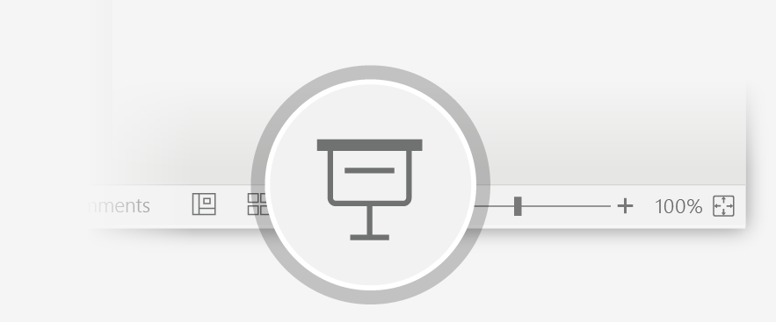
Now Animate Your 3D Model Using the Morph Transition
Try it yourself with the parrot on the right:
1
Duplicate this slide: Right-click the slide thumbnail and select Duplicate Slide.
2
In the second of these two identical slides, change the 3D Model on the right in some way (rotate, move, or resize), then go to Transitions > Morph.
3
Return to the first of the two slides and press the Slide Show button and then select Play to see your parrot morph!

Slide 9
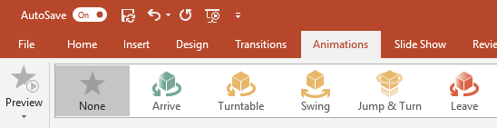
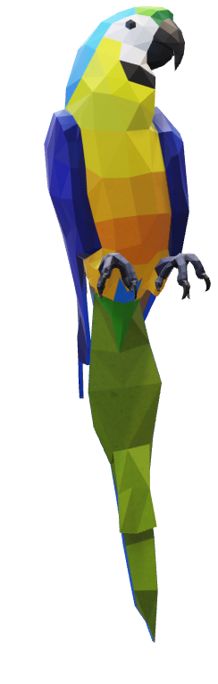
Animate Your 3D Model Using the Animations Tab
Try it yourself with the parrot on the right:
1
Select the 3D Model on the right, then go to Animations > Turntable
Hint: Effect Options gives you even more options for Turntable.
2
Explore the other new animations designed specifically for 3D models: Arrive, Swing, Jump & Turn, and Leave.
3
Click Add Animation to combine the new 3D animations with other classic 2D animations, such as Fade, Grow/Shrink, or one of the many Motion Path animations to test and see what is possible.

Slide 10

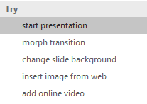

More questions about PowerPoint?
Select the Tell Me button and type what you want to know.
Visit the PowerPoint team blog
Go to free PowerPoint training
SELECT THE ARROW WHEN IN SLIDE SHOW MODE

